Slide 1



Immunometabolism and HIV pathogenesis
Asier Sáez-Cirión, PhD
@asiersc
HIV, inflammation and persistence
Institut Pasteur, Paris, France

Slide 2
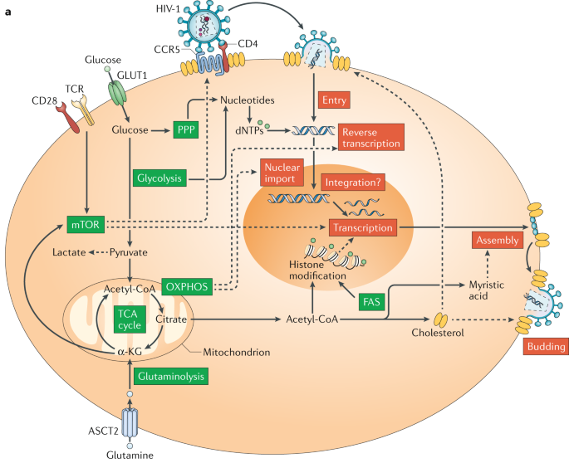
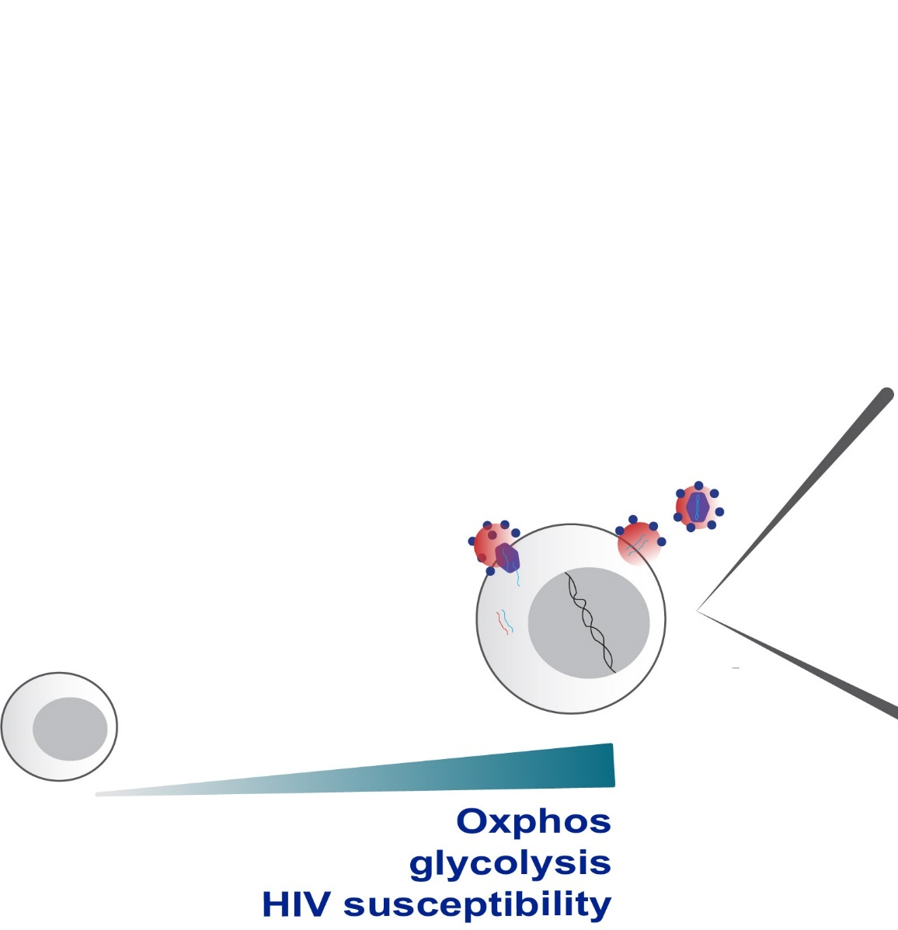
Cell metabolism influences cell susceptibility to HIV-1 infection
All stages of the HIV-1 replication cycle are directly affected by or rely on products of the major cellular metabolic pathways
HIV-1 factors may alter cell immunometabolism to fuel virus replication
Guo et al Nat immunol 2021
Taylor et al Cell reports 2020
Loisel-Meyer PNAS 2012
Clerc et al Nat Metabol 2019
Besnard et al Cell Host Micr 2016
Valle-Casuso et al Cell Metabolism 2019
Sáez-Cirión, Sereti Nat Rev Immunol 2021

Slide 3
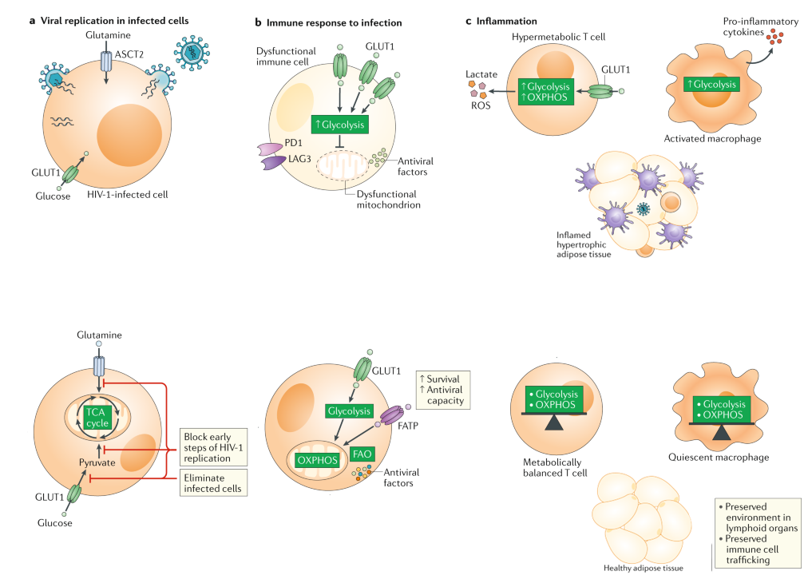
Targeting HIV-1 pathogenesis through immunometabolism based interventions
Palmer et al AIDS 2014
Palner JI 2014
Integrated therapeutic interventions
Metabolic
reprogramming
Metabolic
reprogramming
Sáez-Cirión, Sereti Nat Rev Immunol 2021

Slide 4
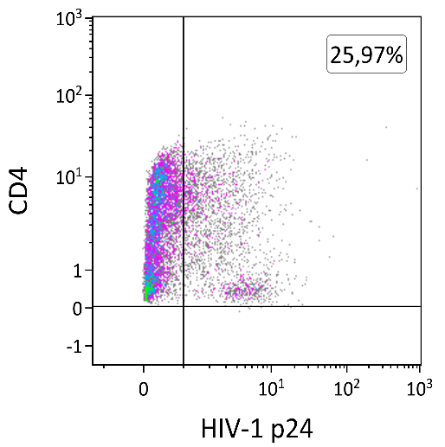
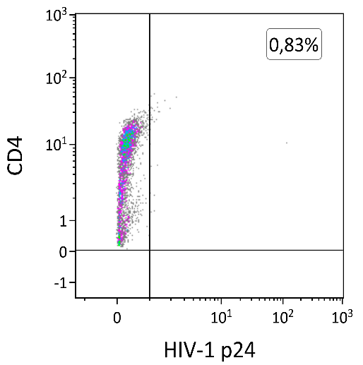
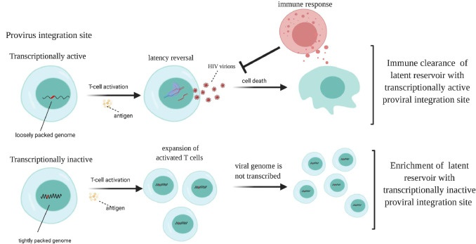
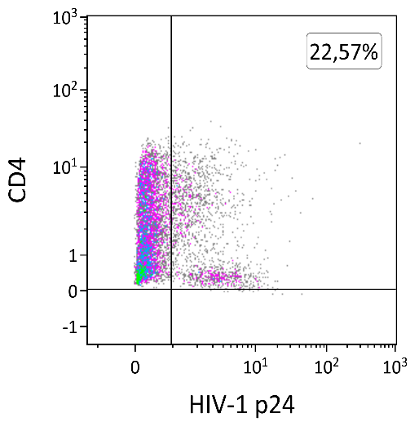
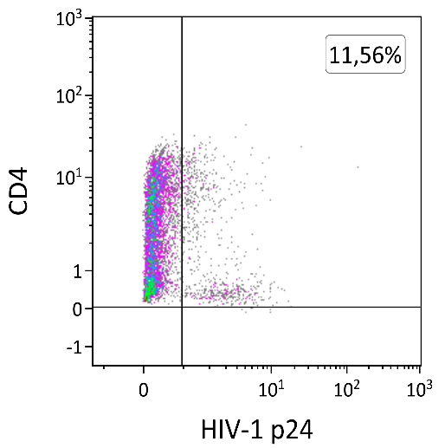
HIV controllers (HIC): natural control of HIV-1 infection
1000
2500
Most HICs were infected with replication competent viruses, but carry a lower frequency of infected cells that other PLWH
800
2000
600
1500
Avettand-Fenoel et al, Clin Microb Rev 2016
CD4 T cell counts/µl
HIV-1 RNA (copies/ml plasma)
400
1000
Large proportion of genome-intact proviral sequences located in regions showing weaker transcriptional activity
200
500
0
0
Jiang et al, Nature 2020
1990
1995
2000
2005
2010
Control of infection may last decades
Efficient CD8 T cell responses in HIC
Immune pressure preferentially eliminate proviral sequences
that are more permissive to viral transcription
CD4 alone
CD8:CD4 1:1
HIV controller
HIV non-controller
Saez-Cirion et al,
PNAS 2007
Nat Protoc 2010
Woldemeskel et al, Ebiomedicine2020

Slide 5

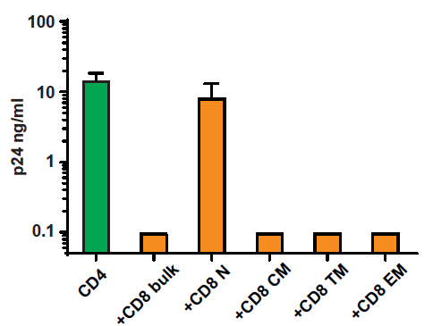
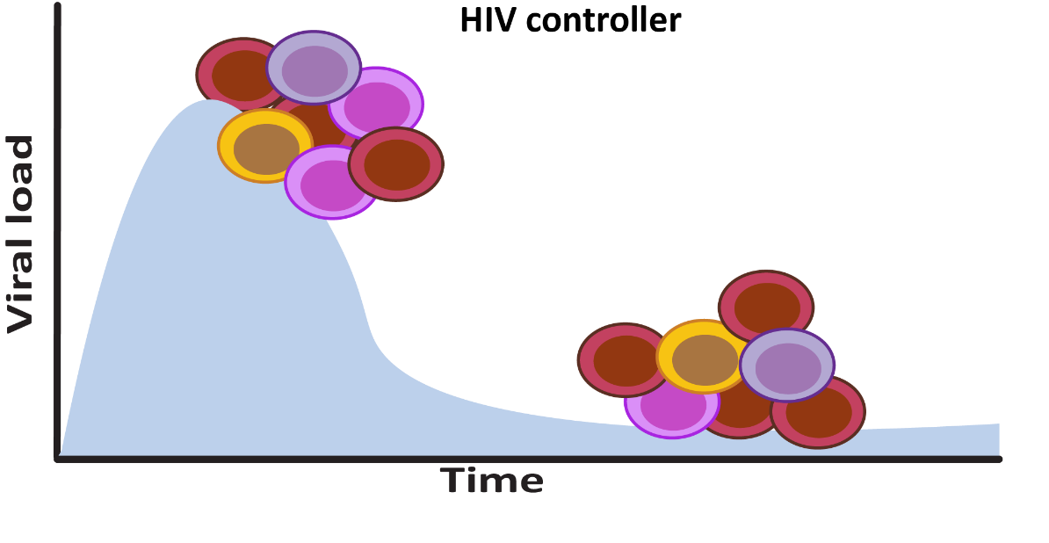
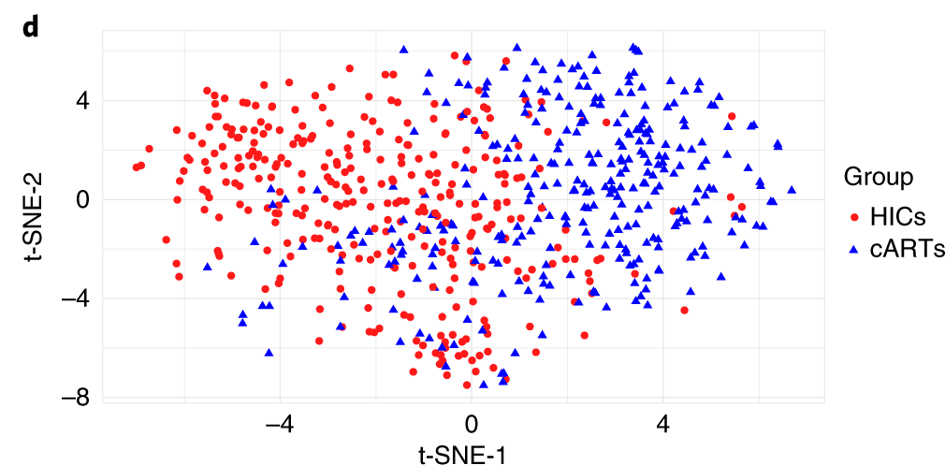
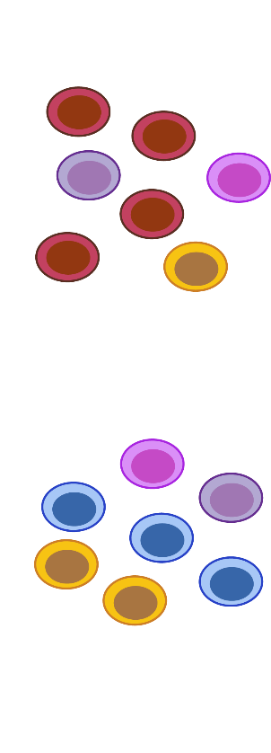
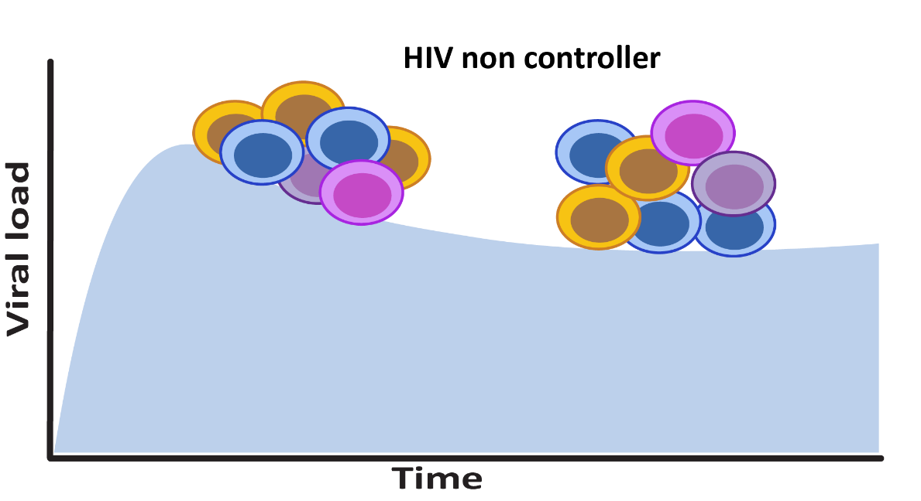
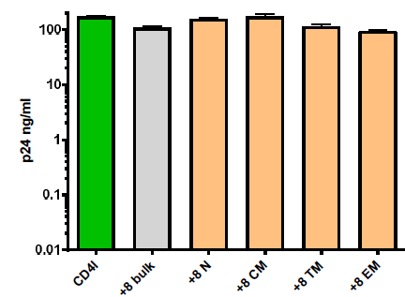
The superior HIV-suppressive capacity of CD8+ T-cells from HIC is likely the result of different priming and engraved in the CM population
Mathieu
Angin
mTOR and metabolic pathways differently regulated in HIV-specific Central Memory
CD8+ T cells from HIC and cART
HIC
Non controller
Single cell analysis
Of HIV-specific CM CD8+ T cells
Angin et al. Nature Metabolism 2019

Slide 6
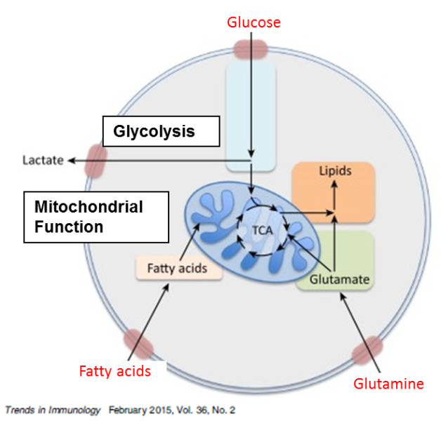
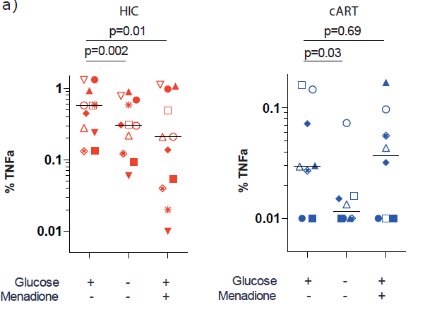
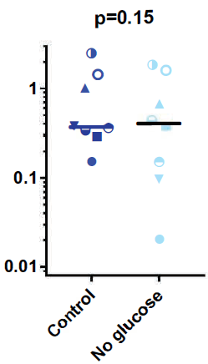
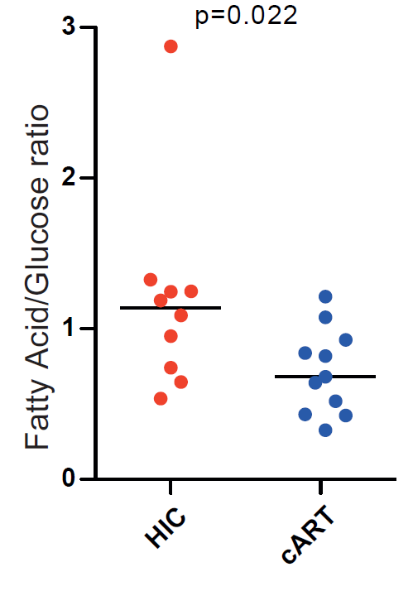
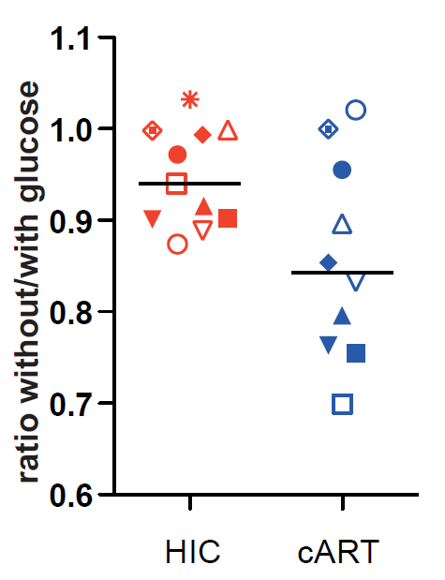
Enhanced capacity of CD8+ T cells from HIV controllers associated with metabolic plasticity
Cytokine production
HIV-specific
CMV-specific
cART
HIF-1α
Metabolite uptake
Cell survival
P=0.06
Different CD8 T cell functions mobilize different metabolic resources
Angin et al. Nat Metabol 2019

Slide 7
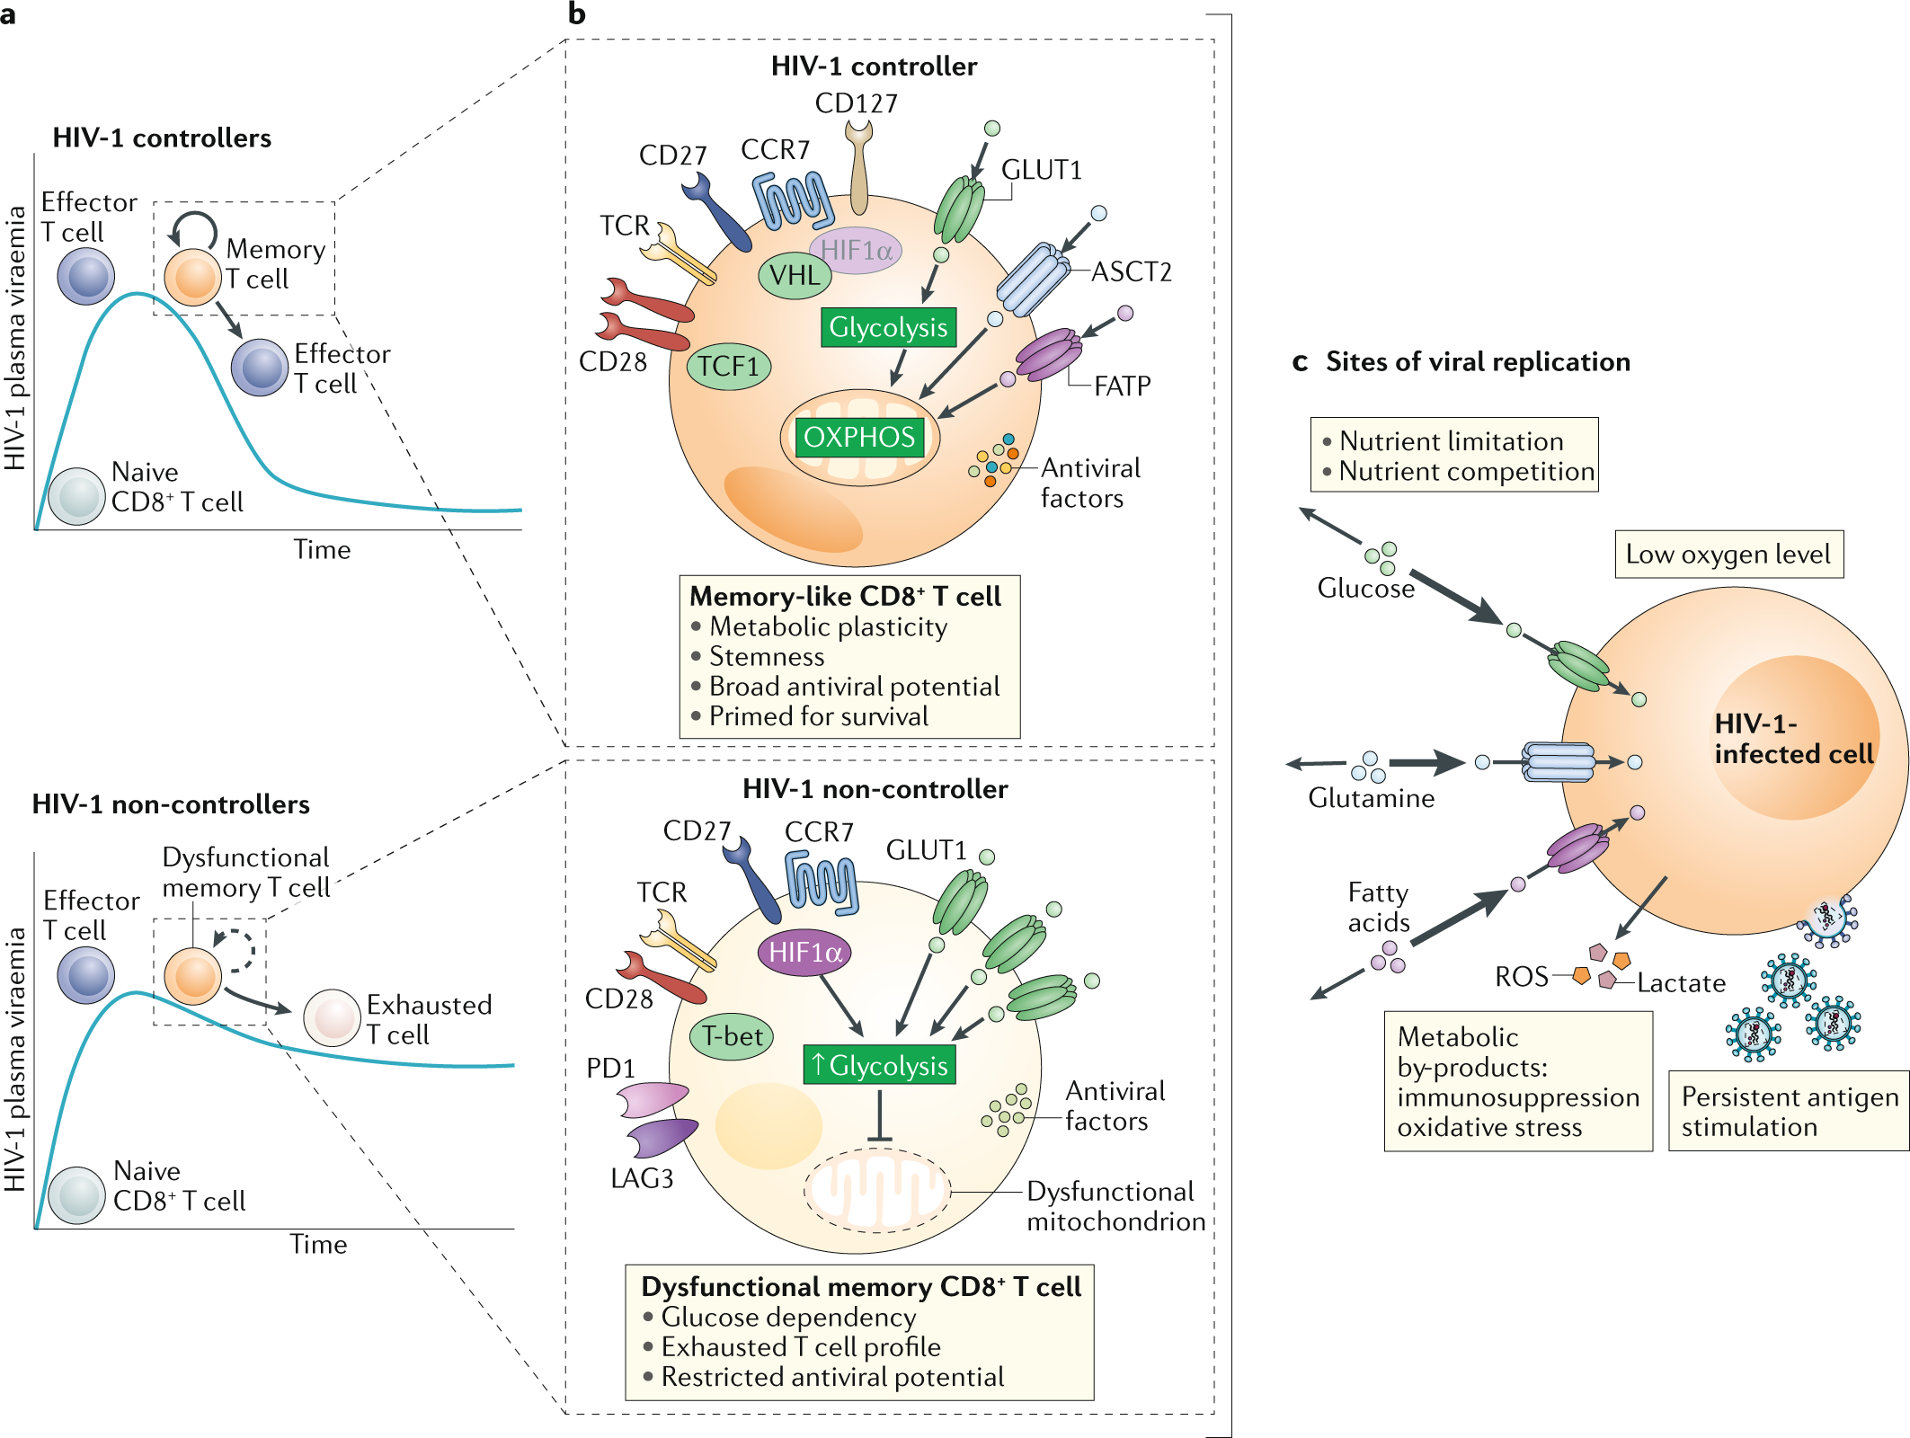


Different metabolic profiles associated with control or progression of infection
Can we re-program CD8 T-cells from non controllers to enhance their stemness and anti-viral potential?
CD8 cART
CD8 HIC
?
Saez-Cirion, Sereti. Nat Rev Immunol 2020

Slide 8
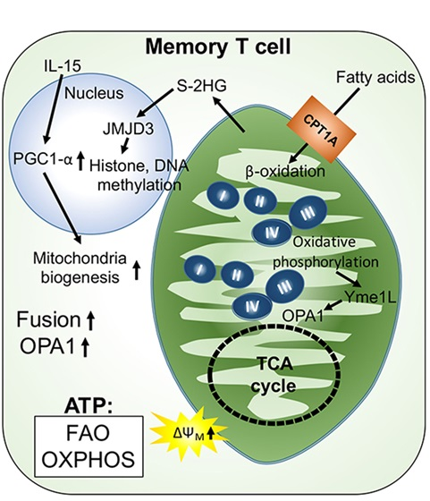
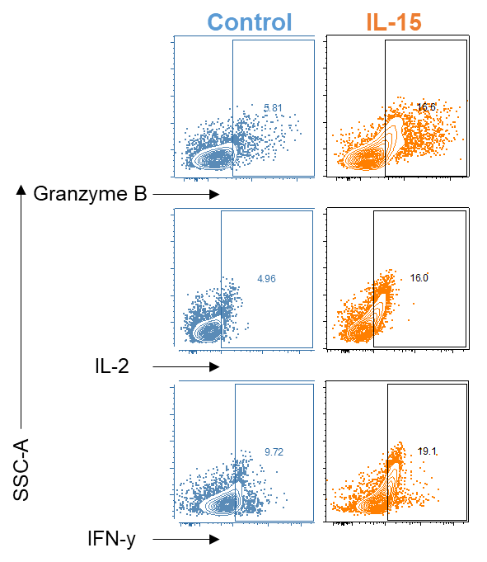
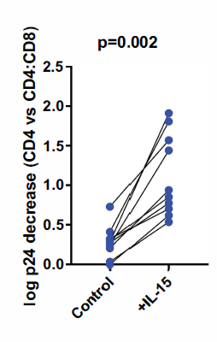
IL-15 enhances the metabolic fitness of HIV-specific CD8+ T cells from non-controllers
Increased magnitude of HIV response and abrogated glucose dependency
IL-15 enhanced mitochondrial activity
P=0.008
HIV
CMV
P=0.06
IL-15 induces mitochondria
neogenesis
P=0.008
P=0.94
Angin et al. Nat Metabol 2019
Enhanced HIV suppressive capacity
5.8%
16.6%
Chao et al Front Immunol 2017
Van der Windt 2012
5.0%
16%
9.7%
19.1%
Perdomo-Celis et al. Unpublished

Slide 9

GSK3β inhibition prevents effector differentiation and exhaustion
Differentiation
Hallmark of natural control
Sekine T. et al. Sci. Immunol, 2020
Passaes et al Cell Reports 2020
Rutishauser RL. et al. JCI Insight, 2020
GSK3β inh DMSO
Perdomo-Celis et al. Unpublished

Slide 10
GSK3β inhibition restrains metabolic activity and promotes TNF-α production
Cell activity sustained in mTORC2
Stimulated cells are less metabolite greedy
mTORC2
(glucose)
(fatty acids)
mTORC1
Promotion of TNF-α and maintenance of other effector activities
Perdomo-Celis et al. Unpublished

Slide 11
GSK3β inhibition: HIV-specific CD8⁺ T cells with memory and antiviral potential
Promotion of memory
Sustained mTORC2 activity
cART
Enhancement of polyfunctionality
Survival in absence of glucose
Perdomo-Celis et al. Unpublished

Slide 12
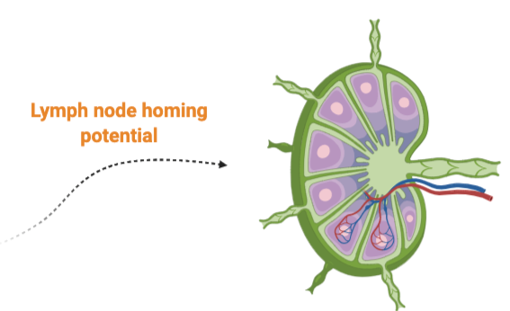
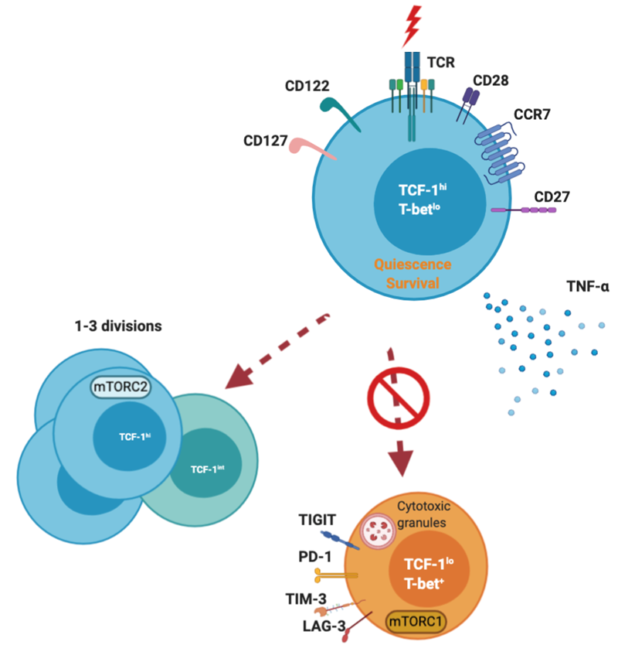
Summary
CD8⁺ T cells from HIV controllers have a different transcription profile at the single cell level compared to non-controllers despite sharing same differentiation phenotype
HIV controllers’ memory cells ➔ metabolic plasticity, primed for survival, enhanced antiviral potential
Metabolic plasticity enhances the capacity of cells from HIC to function in conditions of stress
Ex vivo metabolic reprogramming reinvigorates HIV-specific CD8+ T cell responses from non-controllers and may constitute a new therapeutic opportunity to achieve HIV remission
Cell therapies?
Perdomo-Celis et al. Unpublished

Slide 13








Acknowledgements
Thanks to volunteers and physicians who participate to our studies
Regulation of Retroviral Infections
Françoise Barré-Sinoussi
Gianfranco Pancino
Pierre Versmisse
IDMIT
Roger Le Grand
Bruno Vaslin
Nathalie Dereuddre-Bosquet
Delphine Desjardin
Immunoconcept
Victor Appay
Laura Papagno
Mariela Piccin
Institut Curie
Nicolas Manel
Xavier Lahaye
CHU Necker
Veronique Avettan-Fenoel
Christine Rouzioux
Adeline Mélard
HIV inflammation and persistence
Michaela Müller-Trutwin
ANRS CO21 CODEX
ANRS CO6 “PRIMO”
CHU Bicetre
Olivier Lambotte
Nicolas Noel
Antoine Cheret
Cecile Goujard
Jean-François Delfraissy
Alain Venet
Camille Lécuroux
INSERM U1018
Laurence Meyer
Faroudy Boufassa
Asma Essat
Samia Hendou
Azeb Tadesse
  Viral Reservoirs and Control
Mathieu
Angin
JC
Valle-Casuso
Stevenn Volant
Marie-Agnès Dillies

