Slide 1
Inflammation and tissue damage in the CNS in the ART era
Tricia Burdo, Ph.D.
Associate Professor
Temple University
Lewis Katz School of Medicine
Philadelphia, PA, USA

Slide 2
COI Disclosure
Dr. Burdo hold equity in Excision BioTherapeutics, Inc. and is a member of the Scientific Advisory Board.

Slide 3
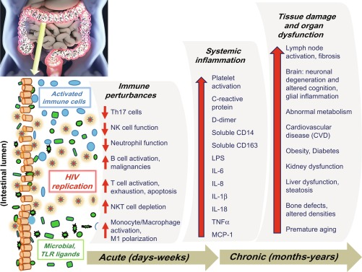
Microbial translocation, immune perturbances and chronic inflammation leads to tissue damage
Lewis and Couturier, Ch. 6 In Perspectives in Translational Cell Biology, Translational Inflammation, 2019

Slide 4
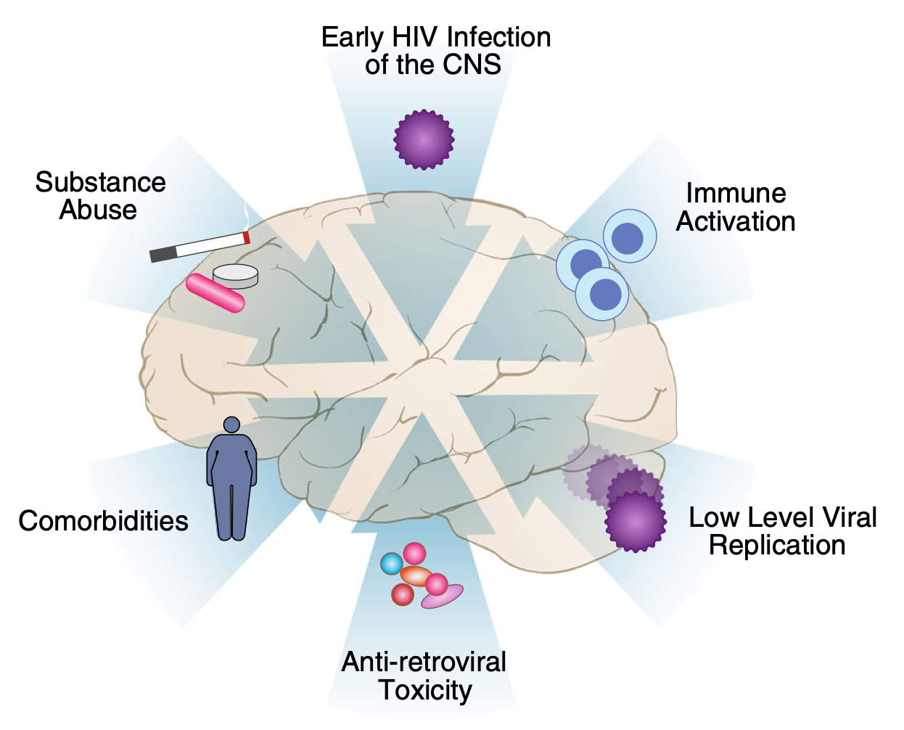
The pathogenesis of HIV-associated neurocognitive disorder is multifactorial
Early introduction of HIV into the CNS establishes a reservoir of infection that continues to drive neuroinflammation
CNS fulfills the major criteria to be classed as an HIV-1 viral reservoir
Peripheral inflammation
Persistent viral transcription
Farhadian et al, Curr Infect Dis Rep, 2017

Slide 5
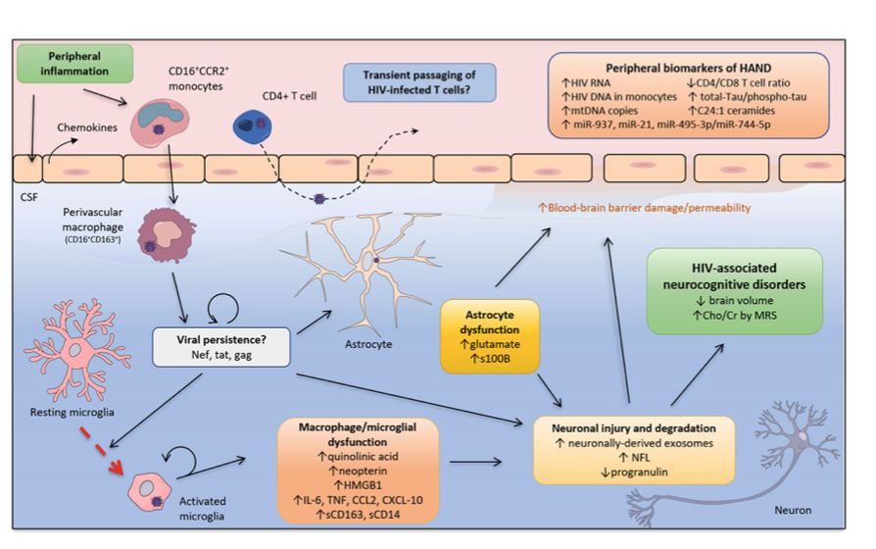
Monocytes and markers of monocyte of activation play a key role in CNS pathogenesis
Angelovich et al. Curr Top Behav Neurosci. 2020

Slide 6
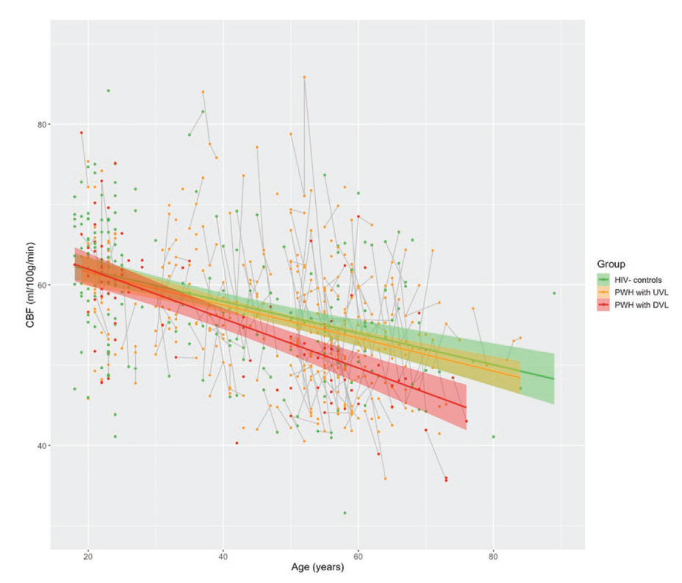
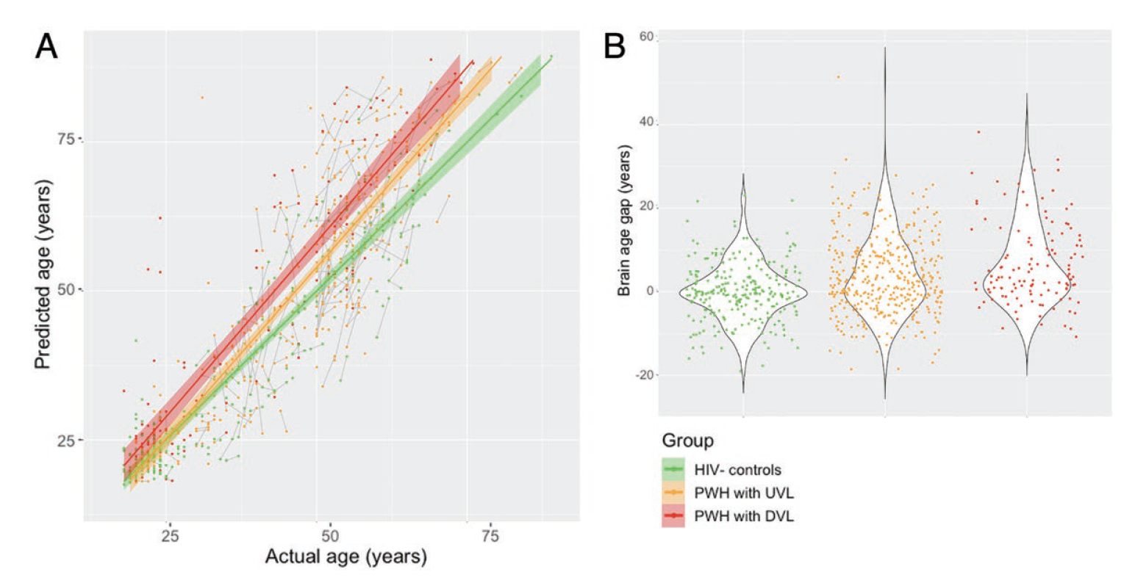
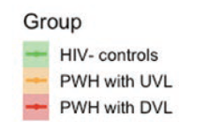
Accelerated Brain Aging and CBF Reduction in PWH
Cerebral blood flow depends
on age and viral load
Structural aging is accelerated in PWH
Cerebral blood flow
Age (years)
PWH w/ undetectable viral loads
PWH w/ detectable viral loads
Petersen et al, CID, 2021

Slide 7
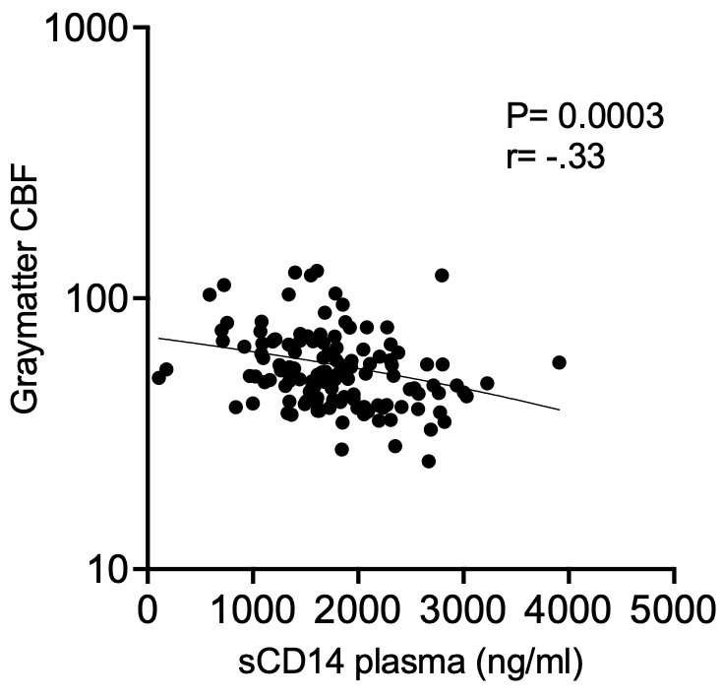
Elevated sCD14 plasma levels correlates with lower cerebral blood flow
Brain region | P value | R value
Thalamus | .0077 | -.23
Putamen | .005 | -.24
Pallidum | <.0001 | -.35
Hippocampus | .01 | -.22
Amygdala | .0002 | -.33
Insula | .003 | -.26
Frontal | .0003 | -.31
Parietal | .0006 | -.30
Temporal | .001 | -.28
Occipital | .0007 | -.30
Graymatter | .0003 | -.33

Slide 8
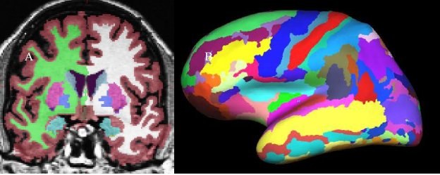
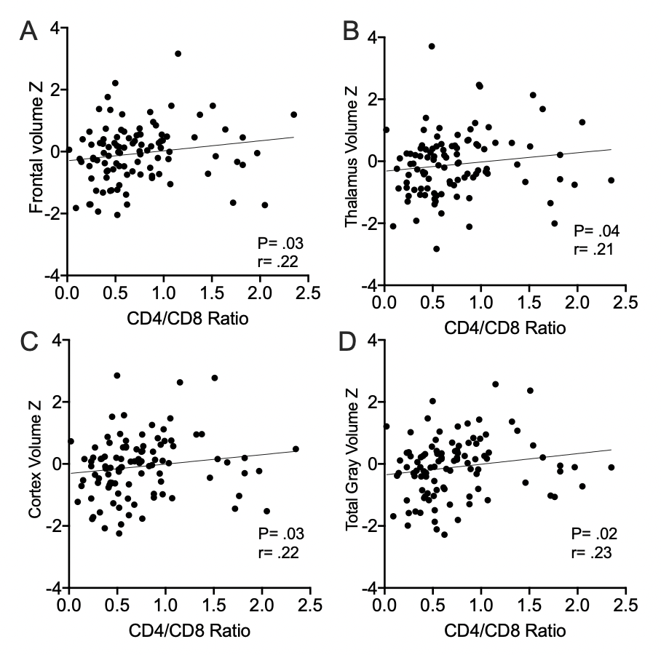
Lower CD4/CD8 ratio correlates with decreased brain volume (structure)

Slide 9
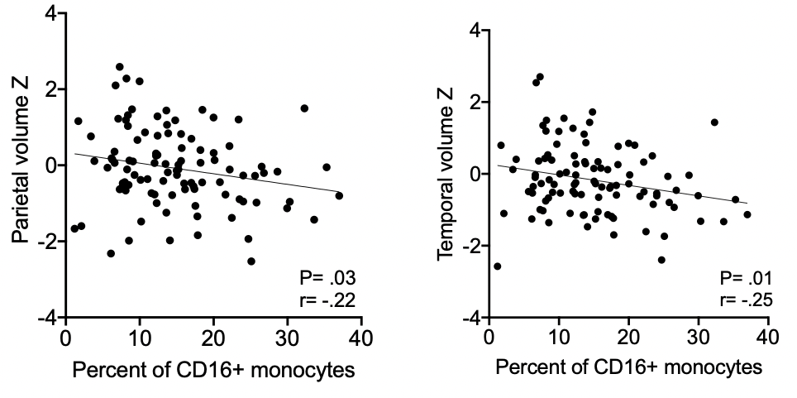
Increased inflammatory CD16+ monocytes correlates with lower brain volumes

Slide 10
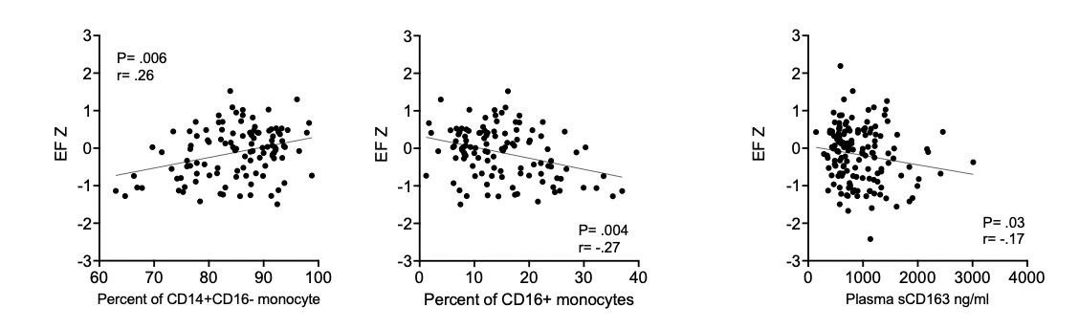
Elevated peripheral monocyte inflammation correlates with lower effector function
Classical monocytes
Inflammatory and
patrolling monocytes
Soluble CD163

Slide 11
Conclusions
Neuroinflammation and CNS tissue damage persist despite ART
Cerebral blood flow involves dynamic, viral load responsive changes at the vascular level, which may be mitigated by ART.
Decreased CBF correlates with elevated sCD14 plasma levels and may represent an acute response.
Structural aging (decreased brain volumes) results from a legacy effect of early tissue damage and this damage relates to an overall immune cellular dysfunction with a lower CD4/CD8 ratio and elevated CD16+ inflammatory monocytes.
Both decreased volumes and inflammatory monocytes correlated to cognitive impairment.

Slide 12


Acknowledgments
Maurizio Caocci, Ph.D.
Jake A. Robinson
Rebecca Warfield
Rachel Podgorski
Mandy Smith, M.P.H.
Jackie Flynn
R01 MH118031 and S1
R01 HL141132
P30 MH092177
T32 MH079785
R56 AI143647
R56 AI150772
Beau Ances, MD, PhD
Elizabeth Westerhaus, MA
Sarah Cooley, Ph.D.
and their team
Disclosures:
TB holds equity in Excision Biotherapeutics and is a member of their SAB.

