Slide 1
Impact of CMV on HIV Outcomes
Peter W. Hunt, MD
Division of Experimental Medicine
University of California San Francisco
USA

Slide 2
Disclosures
Merck: donated drug for clinical trial
Viiv: consulting
Gilead: research grant, honorarium
Biotron: consulting

Slide 3
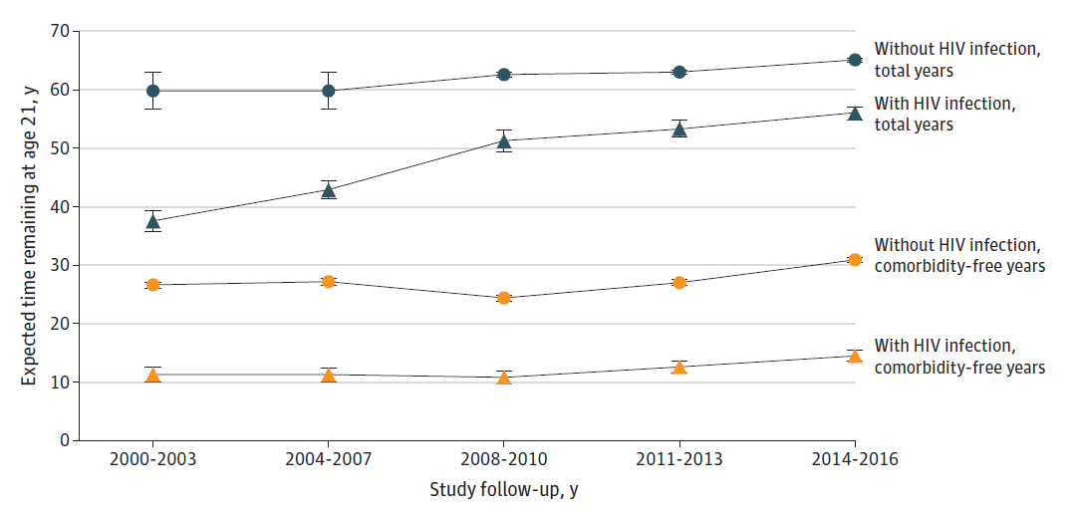
Life expectancy gap in HIV is narrowing Particularly those with high CD4 nadir
Peter W. Hunt, MD
CMV Impact on HIV Outcomes
Total years
HIV-
HIV+
9-year gap
CD4 nadir >500:
6-year gap
Marcus et al, JAMA Network Open 2020

Slide 4
The comorbidity-free life expectancy gap still lags
Even in those with high CD4 nadirs
Peter W. Hunt, MD
CMV Impact on HIV Outcomes
Total years
HIV-
HIV+
15-year gap
Comorbidity*-
free years
CD4 nadir >500:
10-year gap
HIV-
HIV+
*Chronic liver, kidney, or lung disease; diabetes; cancer; CVD
Marcus et al, JAMA Network Open 2020

Slide 5
Mortality Even Higher in Those with
Poor CD4 Recovery during ART
ART-CC and COHERE
Peter W. Hunt, MD
CMV Impact on HIV Outcomes
CD4 after 3y ART
>500
351-500
200-350
63% Non-AIDS Causes of Death
<200
~2.5%
per year
(15% of cohort)
10-year mortality for CD4<200: ~25%
Engsig et al, CID, 2014

Slide 6
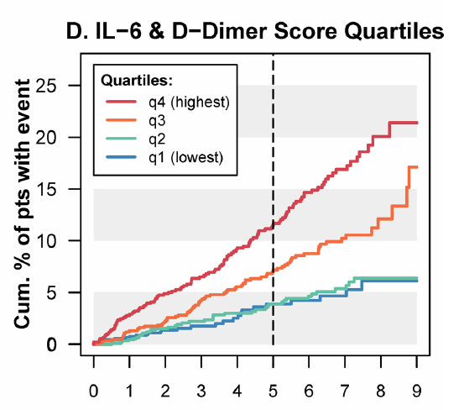
Inflammation Persists during ART and Predicts Morbidity
Peter W. Hunt, MD
CMV Impact on HIV Outcomes
…but the optimal interventional targets remain unclear.
SMART / ESPRIT / SILCAAT (Median Current CD4: 500; Nadir: 181)
Years
Grund, PLoS One, 2016
Justice, JID, 2018

Slide 7
Peter W. Hunt, MD
CMV Impact on HIV Outcomes
CMV Elicits Massive Immune Responses Even in Asymptomatic People without HIV
Sylwester/Picker, JEM, 2005

Slide 8
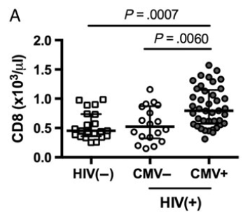
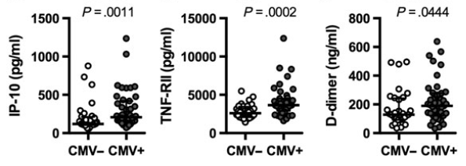

Peter W. Hunt, MD
CMV Impact on HIV Outcomes
CMV Causes CD8 Expansion and Inflammation in HIV Infection
CD8+ T Cell Counts
IP-10
sTNF-RII
D-Dimer
CMV causes ↑CX3CR1 expression on T cells/monos to vascular tissue
CX3CR1+ CD8s also express PAR-1, which can activate coagulation cascade
CMV viremia (or prior end organ dz) predicts venous thromboembolism in HIV
Mike Freeman, PhD
CWRU
Freeman, JID, 2014 (see also: Sacre, AIDS, 2011;
Mudd, JID, 2016; Musselwhite, AIDS 2011; Chen J Immunol, 2020)

Slide 9
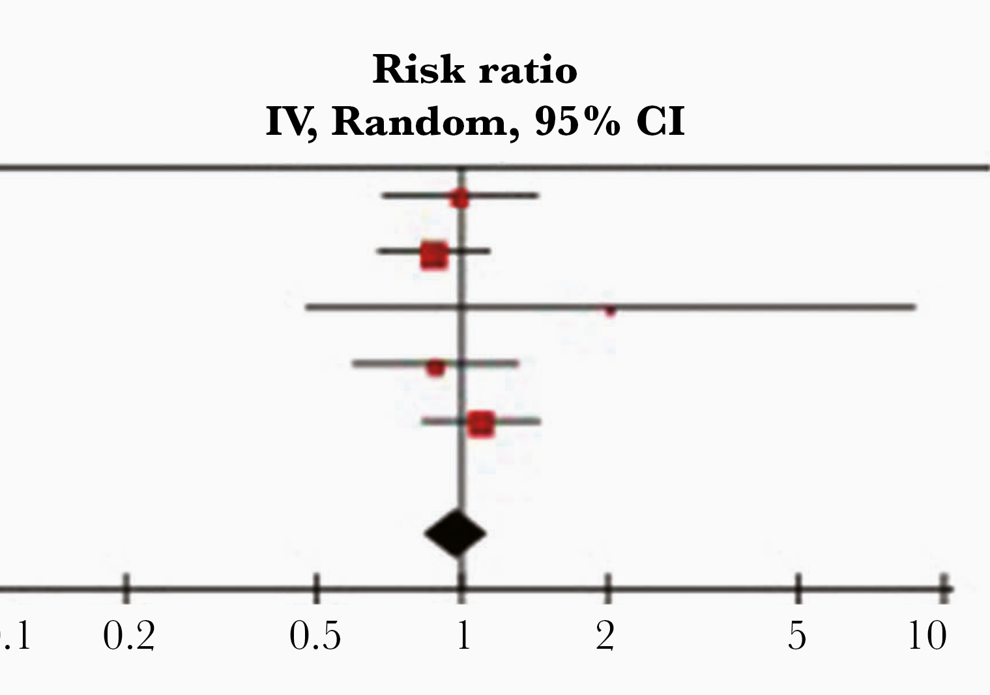
Cardiovascular Effects of CMV in
People without HIV
Inflammation and Immunosuppression Likely Key
Peter W. Hunt, MD
CMV Impact on HIV Outcomes
CMV replicates in vascular endothelium
82% of carotid plaques from endarterectomy CMV DNA+(Nikitskaya, JAHA, 2016).
In MI patients without HIV, 78% had CMV DNA detectable in plasma (Nikitskaya, JAHA, 2017).
CMV IgG+ predicts ↑ mortality in ACS patients with elevated IL-6 during MI (Blankenburg, Circulation, 2001).
CMV prophylaxis with ganciclovir appears to decrease transplant vasculopathy (Valantine, Circ, 1999)
CVD Mortality Meta-Analysis
Chen, JID, 2021

Slide 10
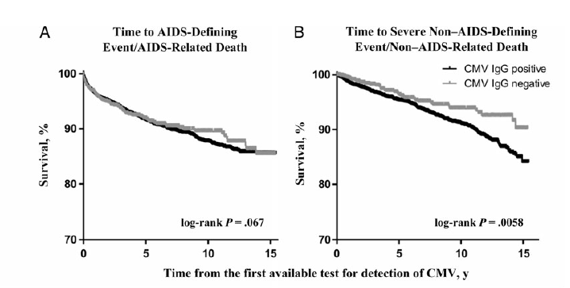
Peter W. Hunt, MD
CMV Impact on HIV Outcomes
CMV IgG+ Predicts Non-AIDS Events in Treated HIV
(and less so AIDS…): ICONA Cohort
Strongest effect for CAD (HR 2.3)
Lichtner et al, JID, 2015

Slide 11
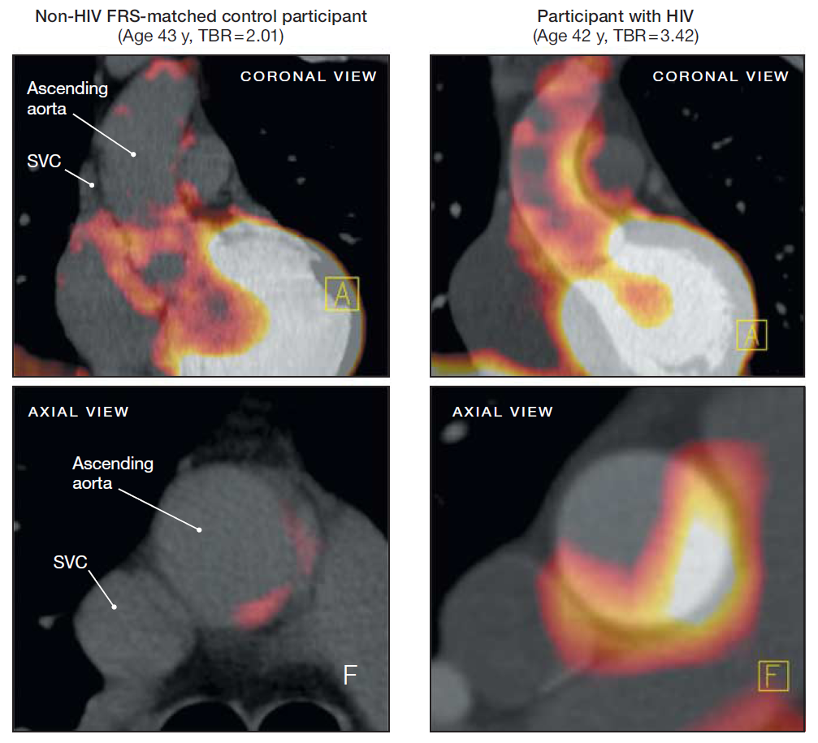
Peter W. Hunt, MD
CMV Impact on HIV Outcomes
Increased Arterial Inflammation in HIV
HIV-
HIV+
Aortic Inflammation was associated with ↑sCD163, a monocyte / macrophage activation marker
Subramanian/Grinspoon, JAMA, 2012

Slide 12
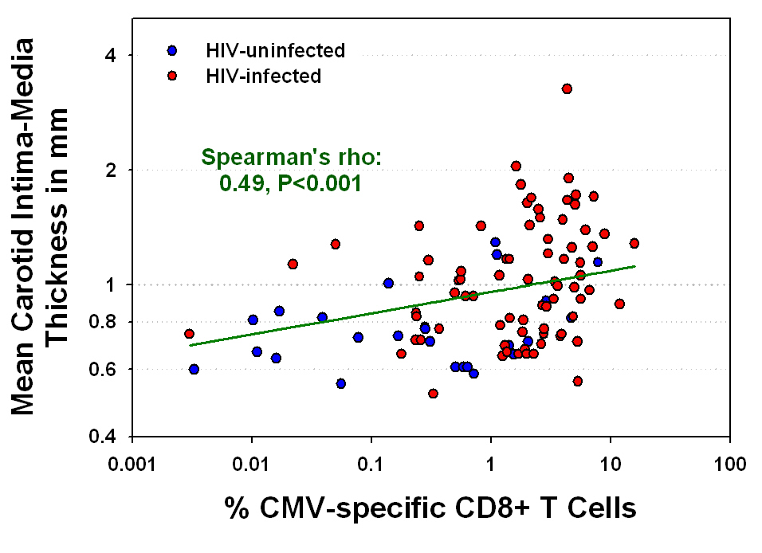

Peter W. Hunt, MD
CMV Impact on HIV Outcomes
Higher CMV-specific CD8 IFN-g Production Associated with More Atherosclerosis
Priscilla Hsue, UCSF
Hsue et al, AIDS, 2006 (see also: Parrinello, JID, 2012; Lo, AIDS, 2010)

Slide 13
Peter W. Hunt, MD
CMV Impact on HIV Outcomes
Higher CMV IgG Titer Also Predicts Type I MI and Venous Thromboembolism in Treated HIV
Sam Schnittman, MD
UCSF medical resident
now BWH/MGH ID fellow
Schnittman et al, CROI 2021, #98

Slide 14
A role of CMV in Other
Non-AIDS Complications?
Peter W. Hunt, MD
CMV Impact on HIV Outcomes

Slide 15
Might CMV Increase T2DM Risk?
Peter W. Hunt, MD
CMV Impact on HIV Outcomes
T2DM common in treated HIV
Might CMV Play a Role?
↑T2DM incidence post solid organ transplant (Shivaswamy, Endocrine Rev, 2016)
CMV expressed in adipose tissue (Shnayder, mBio, 2018)
↑Putatively CMV-specific CD8+ T cell infiltration of fat in HIV/SIV (Wanjalla, Front Immunol, 2018)
↑Adipose tissue fibrosis in HIV (Couturier, AIDS, 2015)
CD8 infiltration of adipose tissue and fibrosis precede NASH and insulin resistance in obesity (Nishimura, Nat Med, 2009)
1%/year incidence!
Rebeiro for NA-ACCORD, CID, 2020

Slide 16
CMV Infection Causes Adipose Tissue Inflammation and Insulin Resistance in Mice
Peter W. Hunt, MD
CMV Impact on HIV Outcomes
CD8 TRMs
Inflammation
Insulin Resistance
Contreras, PLoS Path, 2019

Slide 17
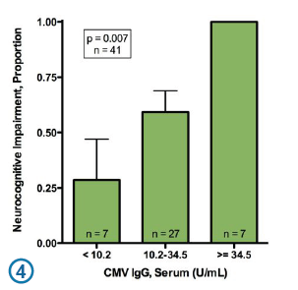

Peter W. Hunt, MD
CMV Impact on HIV Outcomes
CMV IgG Titer Associated with Neurocognitive Impairment in Treated HIV Infection
Similar relationship seen in elderly HIV- populations (Vescovini, JI, 2010)
Scott Letendre, MD
UCSD
Letendre, CID, 2018

Slide 18
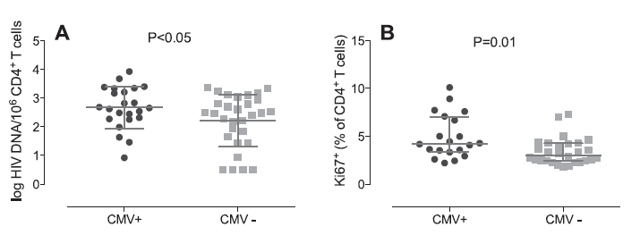

Peter W. Hunt, MD
CMV Impact on HIV Outcomes
Seminal CMV Shedding Associated with Higher HIV Reservoirs in PBMC
Gianella, JV, 2014
Sara Gianella, MD
UCSD

Slide 19
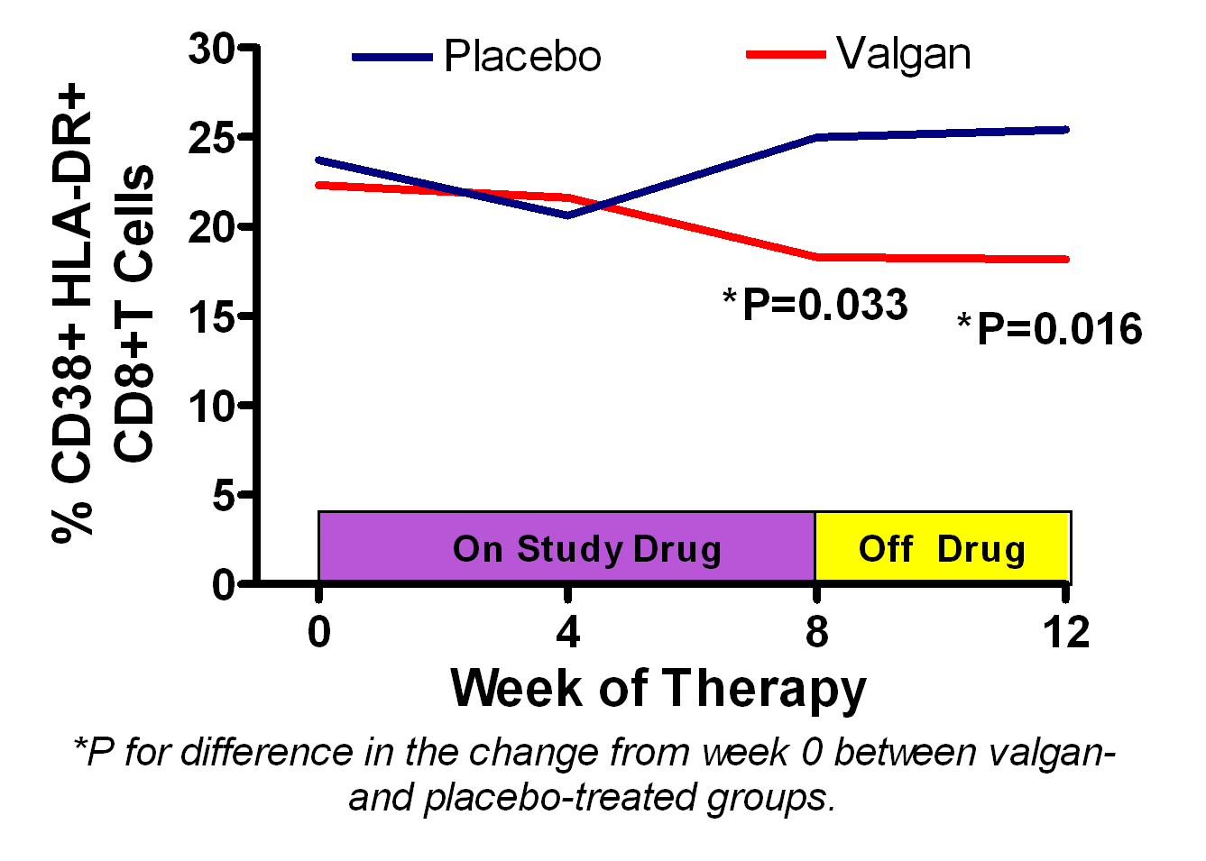
Peter W. Hunt, MD
CMV Impact on HIV Outcomes
Blocking Asymptomatic CMV Replication with Valganciclovir ↓ Immune Activation
in HIV+ Patients with CD4<350 despite ART
-4.4%
HIV-
Median
Hunt et al, JID, 2011

Slide 20
Valganciclovir Broadly Decreased Innate Immune Activation in Treated HIV
Peter W. Hunt, MD
CMV Impact on HIV Outcomes
sTNF-RII
sCD163
Corresponds to ~22% decrease in MI/Stroke
(Tenorio, JID, 2014)
Beck-Engeser, CROI 2019, #643; Sevilla, CROI 2020, #236

Slide 21
Peter W. Hunt, MD
CMV Impact on HIV Outcomes
A5383: Letermovir to Reduce Immune Activation in Treated HIV (n=180)
Letermovir 480mg daily
+ Continued ART
ART alone
CMV IgG+
ART+, VL<40 >1y
Stratify to ensure:
1/2 CD4<350
1/3 Cis-women
1:1
Placebo 480mg daily
+ Continued ART
ART alone
Co-Chair
Sara Gianella
UCSD
Week_ | -4 | -2 | 0 | 4 | 8 |  | 24 | 36 | 42 | 46 | 48 | 52 | 60
CMV DNA |  | X | X |  | X |  | X |  |  | X | X | X | X
Immunology |  | X | X |  | X |  | X |  |  | X | X | X | X
HIV virology |  | X | X |  | X |  | X |  |  | X | X | X | X
FDG-PET/CT |  | X |  |  |  |  |  |  |  | X
Fat Biopsy |  |  | X |  |  |  |  |  |  |  | X
LP substudy |  |  | X |  |  |  |  |  |  |  | X
GALT | X |  |  |  |  |  |  |  | X
Collaborators: Freeman (CWRU); Tawakol (Harvard); Koethe (Vanderbilt); Shacklett (UCD)

Slide 22
Conclusions / Implications
Peter W. Hunt, MD
CMV Impact on HIV Outcomes
Valganciclovir substantially reduces multiple immune activation pathways in treated HIV.
  Corresponds to markedly reduced risk of MI and T2DM
  Unclear if valganciclovir effect reflects suppression of CMV vs. other herpesviruses (EBV, HSV1-2, KSHV, HHV6)
  Unclear if results generalize to higher CD4 counts and women.
  Also unclear if treating asymptomatic CMV will improve surrogate markers of end-organ disease.
Letermovir trial should begin to address these issues.

Slide 23


Peter W. Hunt, MD
Acknowledgements
CMV Impact on HIV Outcomes
Hunt Lab
Gabriele Beck-Engeser
Sabrina Ann Sevilla
HaeLee Ahn
Vanessa York
Katya Maidji
SCOPE/OPTIONS/UCSF
Steve Deeks
Jeff Martin
Rebecca Hoh
SCOPE team
Drug Research Unit
Fran Aweeka
Amelia Deitchman
NCI Frederick
Frank Maldarelli
UCSF CFAR Core Immunology Lab
Elizabeth Sinclair, Lorrie Epling
SFGH Cardiology
Priscilla Hsue
U Vermont Burlington
Russel Tracy
CWRU
Michael Lederman
Mike Freeman
U Washington
Larry Corey
U Vanderbilt
John Koethe
MGH/Harvard
Ahmed Tawokol
UCSD
Sara Gianella
Davey Smith
USC
Michael Dube
R01AI110271, R01DK112304
R56AI100765, 1R21AI087035, 1R21AI07877
DDCF CSDA
Roche, Inc.

