Slide 1
The Face in the Mirror Addressing internal stigma

Slide 2
Addressing internal stigma
Shaun Mellors
Director of Programmes & Technical Positive Action, ViiV Healthcare
Conflict:
Employee of ViiV Healthcare (Conference Sponsor). This presentation represents my own personal views and experiences and work done with “Beyond Stigma”

Slide 3
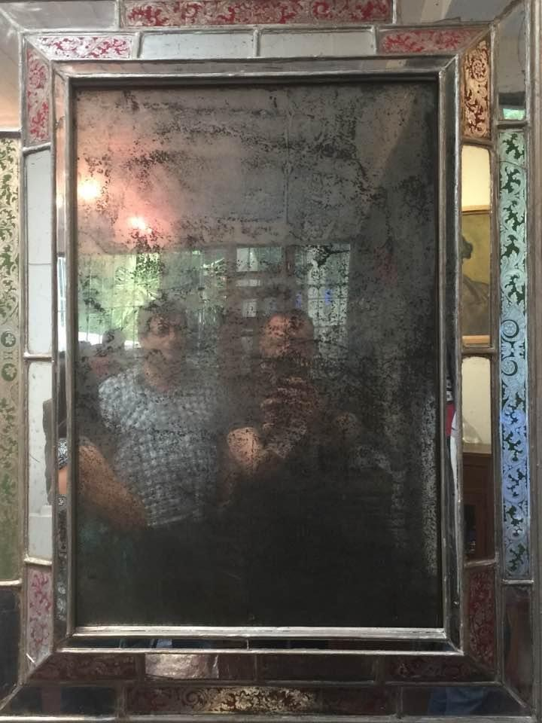
The face in the mirror
Notes:
There was a time that I looked at myself in the mirror and was uncertain of the person who was looking back at me. I was ashamed. I felt shameful. I felt guilty. This person who looked back had been ostracised from his community and his church for being gay. This person who contracted HIV because he was gay. This person was a sinner and this person had no right to the support and love from his faith or his community. I was that person. First confronted with the shame of my homosexuality. That sense of being wrong, being a sin. And of course, an HIV diagnosis was “a punishment from God”, I deserved to “get infected” with HIV as I was seen as a “promiscuous homosexual”, living a “sinful” life.

Slide 4
The silence of stigma
Notes:
Mark s. King of my fabulous disease talks about the “silence of stigma”. That silence can be deafening, but it is also insidious. It cuts deeps, it leaves festering wounds, and it takes a long time to heal. But healing it does. Some of those earlier sentiments of shame and self blame have thankfully changed, but they have not completely gone away. I still have that voice inside my head sometimes that whispers “you are bad, homosexuality is a sin” and that fear or anticipation of shame when I meet people, strangers for the first time, or go to an event can be as overpowering and debilitating as shame itself.

Slide 5
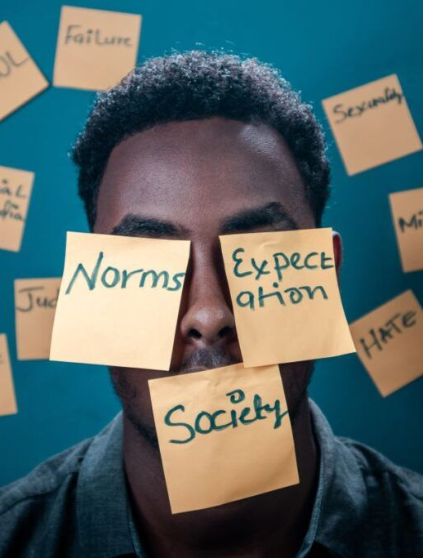
What is self-stigma?
“Self-stigma is a mindset of negative beliefs, thoughts and behaviours and can manifest as shame, guilt, self-loathing and self-rejection and in the context of HIV these negative beliefs, feelings and actions”
Notes:
But what exactly is self-stigma or internalised stigma and how is it different to enacted stigma or discrimination.
Self-stigma is a mindset of negative beliefs, thoughts and behaviours and can manifest as shame, guilt, self-loathing and self-rejection and in the context of HIV these negative beliefs, feelings and actions can manifest different ways.

Slide 6
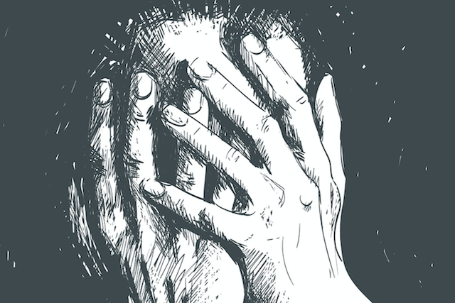
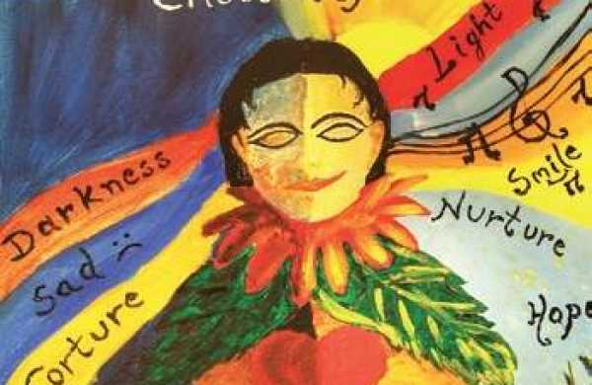
The cycle of self-stigma
Beliefs and thoughts. I have negative thoughts that I am to blame for my HIV, that I deserve HIV
Feeling ashamed, feeling guilty and afraid of judgement
Withdraw socially, ambitions and plans are unimportant and I limit self care
Notes:
Beliefs – I believe negative stereotypes about myself that I am to blame for my HIV and believing that I cannot change or improve my situation
This leads to feelings of shame. Feeling ashamed, feeling guilty and feeling afraid of judgement of what others do, do not do or think and the impact of these beliefs and feelings means that I withdraw socially, my ambitions and future plans become less or unimportant and I limit self-care.

Slide 7
What is the difference between stigma and discrimination?
Stigma: When you think negative things about me because of my HIV status
Stigma is a thought
whilst discrimination is an action.
Self-Stigma: When I think or say negative things about myself because of my HIV status
Discrimination: When you do negative things to me because of my HIV status
Source: Inside Out From the Inside Out: Dealing with TB-related Self-stigma and Shame A toolkit for people with TB to deal with self-stigma and shame - http://www.beyondstigma.org/resources.html
Notes:
In essence stigma (enacted/external and internal/self) is a thought whilst discrimination is an action.

Slide 8
WHAT CAUSES SELF-STIGMA?
The Self
Society
Self-Stigma
Context
Economics, culture, politics
Access to care services
Community support networks
Sources of information
Levels of stigma and discrimination
Source: www.beyondstigma.org Ferris-France, N., S. H. McDonald, R. R. Conroy, E. Byrne, C. Mallouris, I. Hodgson, and F. N. Larkan. 2015. “An Unspoken World of Unspoken Things: A Study Identifying and Exploring Core Beliefs Underlying Self-Stigma among People Living with HIV and AIDS in Ireland.” Swiss Medical Weekly 145: w14113.
Notes:
Self-stigma arises due to interplay of many factors – it is not a simple construct, but very complex and is part of the reason why it is so difficult to address. Instead of being a simple one-dimensional phenomenon, it is dynamic and it is experienced differently by everyone.

Slide 9
WHAT CAUSES SELF-STIGMA?
The Self
Society
Context
Economics, culture, politics
Access to care services
Community support networks
Sources of information
Levels of stigma and discrimination
Belief or meaning systems; mood states (e.g. depression, anxiety); coping skills and resilience; levels of knowledge; life experience and life skills; Self esteem and self awareness; sexuality and disclosure of status
Economics, culture, politics; access to care services; community support networks; sources of information; levels of stigma and discrimination
The individual’s circumstances and conditions; use of drugs or alcohol;
childhood sexual abuse; power relationships; living conditions; time since diagnosis; family circumstances
Source: www.beyondstigma.org Ferris-France, N., S. H. McDonald, R. R. Conroy, E. Byrne, C. Mallouris, I. Hodgson, and F. N. Larkan. 2015. “An Unspoken World of Unspoken Things: A Study Identifying and Exploring Core Beliefs Underlying Self-Stigma among People Living with HIV and AIDS in Ireland.” Swiss Medical Weekly 145: w14113.
Notes:
Our programming and our efforts to truly understand and address self stigma need to take into account the interrelated issues of “the self”, “society” and importantly the “context”
the self – what are the individuals belief system, are they living with depression or anxiety, what is their level of self esteem, have they disclosed their HIV status or their sexual orientation
Society – does the individual live in a hostile environment. Is their SOGI criminalised, what is the economic status of the invidual and the overall response to HIV
Context – when was the individual diagnosed, how were they diagnosed, where are they living, do they use drugs or alcohol?

Slide 10
What works and what does not work in addressing self-stigma
Interventions that resulted in consistent self-stigma reductions were:
ART provision including treatment literacy;
Social empowerment;
Economic empowerment and strengthening;
Cognitive-behavioural therapy
Interventions with null effects on self-stigma were:
Health awareness raising;
Stigma coping and behaviour change (although they were effective for other outcomes just not self-stigma).
Notes:
We did a systematic review in 2019 with the lovely Dr Marija Pantellic as part of my work at my previous organisation, in order to understand what the literature was telling us about what worked in addressing self-stigma. We found the following interventions resulted in self-stigma reduction;
Provision of ART but importantly also support for treatment literacy, including adherence clubs;
Social empowerment including supported leadership roles of PLHIV;
Economic empowerment and strengthening – when a person is able to earn an income, put food on their table and feel that they are contributing through employment or income generation and finally CBT – intervention often used in counselling. The key to these interventions is that they are cost effective and can be provided through trained and resourced community structures.

Slide 11
Recommendations
Differentiate between HIV stigma and HIV discrimination unless explicitly wanting to address the resulting discrimination.
Move away from using the term “self-stigma” and focus on “self-worth
Target interventions or funding on a combination of structural- level and individual-level risks and resilience – the hold promise for addressing “self-worth”.
Measure, measure, measure – and share what works and what does not.
Notes:
We often see stigma and discrimination written together. The interventions to address them are very different and it is often “stigma” that suffers, as these interventions are harder to measure. Remember stigma is a thought, discrimination is an action.
Many colleagues, and I agree, have indicated that the term “self-stigma” is stigmatising itself and some have described the journey as a journey towards self-worth, and I can definitely testify to that – the interventions, leadership training, resilience development, confidence building all contribute to a sense of self worth.
Critically important when planning or funding interventions to address “self-worth” that we focus on the intersectionality between structural and individual level (self, context and society)

Slide 12
Thank you
Special thanks to Nadine and Positive Action team members who contuinue to challenge my thinking and who also reviewed the presentation

