Slide 1
Measuring internalized HIV-related stigma
Measuring HIV-related stigma: How can programme implementers effectively monitor interventions?
Laura Ferguson
Program on Global Health and Human Rights, Institute on Inequalities in Global Health, University of Southern California
Southern California Evidence Review Center

Slide 2
Overview
What is stigma?
Why does it matter for HIV policies and interventions?
What is internalized stigma?
Measuring internalized HIV-related stigma
Practical considerations for implementation

Slide 3
What is stigma?
“An attribute that is deeply discrediting” (Goffman, 1963).
“The co-occurrence of labeling, stereotyping, separation, status loss, and discrimination in a context in which power is exercised” (Hatzenbuehler et al., 2013).
Stigma functions at the intersection of culture, power and difference (Parker & Aggleton, 2003)
Different types of HIV-related stigma: Enacted, community, anticipated, internalized
Intersectional stigma

Slide 4
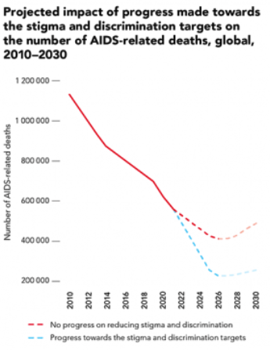
Why does stigma matter?
No progress on HIV-related stigma and discrimination would result in an additional 440,000 AIDS-related deaths between 2020 and 2030
We cannot achieve global, regional and national HIV targets unless we address stigma and discrimination
Experiencing stigma is a negative experience that is detrimental to quality of life
It can lead to depression, social isolation, decreased condom use, lower attendance at health facilities, reduced adherence to ART
Effective HIV interventions require understanding: local levels of stigma, the types of stigma being experienced, their drivers and their impacts on outcomes
Sources: Special analysis by Avenir Health using data from UNAIDS/WHO/UNICEF HIV services tracking tool, November 2020; and UNAIDS epidemiological estimates, 2020.

Slide 5
What is internalized HIV-related stigma?
Internalized HIV stigma occurs when a person living with HIV endorses negative attitudes associated with HIV and accepts them as applicable to her or himself
It is characterized by self-deprecating feelings and cognitions, such as shame, self-blame, embarrassment, guilt and worthlessness
It is associated with the assimilation of these negative attitudes, beliefs, and feelings threatening self-concept and self-esteem
Sources: Pantelic et al., 2019; Relf et al., 2021

Slide 6
Measuring internalized HIV-related stigma
There are many measures to choose from
Some cover stigma broadly with a sub-scale to capture internalized stigma
Some are specific to internalized stigma
Different ones have been adapted for different populations/settings
Content and response options vary
Not all have been validated

Slide 7
Measuring internalized HIV-related stigma: General HIV stigma measures
Name | Author, Year | Structure | Internalized stigma | Languages | Adaptations
HIV stigma scale | Berger et al., 2001 | 40 items; 4-point Likert scale | Negative self-image sub-scale (8 items) | Amharic, Bahasa, Chinese, English, Japanese, Polish, Portuguese, Spanish, Swedish, Tamil, Thai | Youth living with HIV, Asian persons living with HIV in the USA, Spanish speaking urban PLHIV in Peru, Spanish speaking Latinx PLHIV in Puerto Rico, PLHIV in South India, Japanese adults living with HIV, Brazilian adults living with HIV, Adults and youth in Sweden, adults living with HIV in Taiwan
PLHIV stigma index (2.0) | GNP+, ICW, UNAIDS & IPPF, 2018; Friedland, 2020 | Sections: disclosure, experience of S&D, internalized stigma and resilience, interactions with healthcare services, human rights and effecting change, S&D experienced for reasons other than HIV status, personal experience related to S&D | Includes IA-RSS scale (6 items; range: 0,6) and new scale to assess resilience (10 items; scale: -10, 10). | 55 languages | 100 countries

Slide 8
Measuring internalized HIV-related stigma: Specific measures
Name | Author, Year | Structure | Target population | Languages
Internalized AIDS-Related Stigma Scale | Kalichman et al., 2009 | 6 items; dichotomous | Adults living with HIV in South Africa, Swaziland and USA; Uganda and Ireland | Afrikaans, English, Swati, Xhosa
Internalized HIV Stigma Scale | Sayles et al., 2008 | 28 items, 5-point Likert | Adults living with HIV | English, Kinyarwanda, Swahili
Serithi Internalized Stigma Scale | Visser et al., 2008 | 6 items; dichotomous | Pregnant women living with HIV in South Africa | English, IsiZulu, Sepedi, Setswana
Internalized Stigma of AIDS Tool | Phillips et al., 2011 | 10 items; 5-point Likert | Women living with HIV in the Southeastern USA | English
HIV-Internalized Stigma Scale | Hernansaiz-Garrido & Alonso-Tapia, 2017 | 10-items; 5-point Likert | Adults living with HIV in Spanish-speaking countries | Spanish

Slide 9
Sample measure content
Kalichman – Internal AIDS-Related Stigma Scale
Agree/disagree
It is difficult to tell people about my HIV infection
Being HIV positive makes me feel dirty
I feel guilty that I am HIV positive
I am ashamed that I am HIV positive
I sometimes feel worthless because I am HIV positive
I hide my HIV status from others
Hernansaiz-Garrido - HIV Internalized Stigma Scale (incomplete)
Please indicate the degree in which you felt in the following ways during the last month because of having HIV (Never/hardly ever; rarely; sometimes; very often; all or almost all the time)
I felt flawed or incomplete
I felt disappointed with myself
I thought I was promiscuous
I felt repulsion for myself
I thought I’m being punished for having done immoral things
Notes:
Also had dirty, guilty embarrassed.

Slide 10
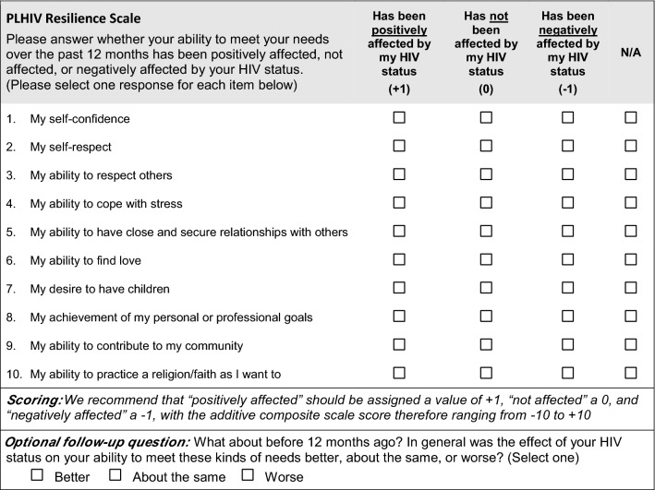
Stigma Index 2.0 resilience scale

Slide 11
Practical considerations
Which measure is most appropriate for your intervention?
General HIV stigma, specific to internalized, intersectional…?
Number of items and response options
Has it been validated in your population(s) of interest?
Adaptation to local context is important… and may limit comparability
How to ensure rigorous study design around your intervention
Sample size
Control group
Longitudinal design

Slide 12
Thank you!
Online: www.globalhealth.usc.edu
On Twitter @USCGlobalHealth
On Facebook @USCGlobalHealth
On Instagram @USCGlobalHealth

