Slide 1
Global declines in HIV testing and reductions in new initiators - what does this mean for the future? John Stover Avenir Health

Slide 2
HIV Service Disruptions due to COVID-19
The COVID-19 epidemic has the potential to cause severe disruptions in health services due to several factors:
Closing of facilities or cessation of services
Shortage of health care workers
Over-burdening of health care staff
Disruptions in supplies for commodities and person protection equipment
Travel restrictions
Fear of accessing health facilities
The effects of these disruptions on HIV testing, new infections, deaths will depend on the duration and severity of the disruptions and the program responses to them
Notes:
Disruptions of HIV services due to COVID can have a number of causes, including closing of facilities, shortage of health care workers, over-burdening of health care staff, disruptions in supplies for commodities and person protection equipment, travel restrictions and fear of accessing health facilities.
The effects of these disruptions on HIV testing, new infections, deaths will depend on the duration and severity of the disruptions and the program responses to them.

Slide 3
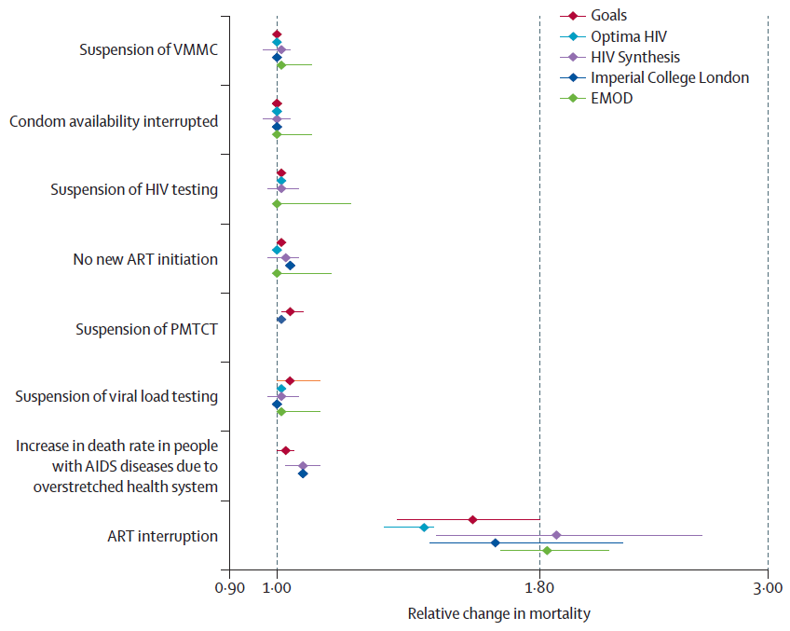
Effects of COVID-related Service Disruptions
Multi-model analysis organized by the HIV Modeling Consortium found
Short-term disruptions in prevention services would have limited impact on HIV-related mortality
Short-term disruptions of ART services could lead to 39-87% increase in HIV-related mortality in 2020 and 15-29% increase over 2020-2025
Assumptions
Service disruption lasting 6 months
Disruption affects 50% of the population
Relative change in mortality is over 12 months (April 2020-March 2021)
Source: Jewel, Mudimu, Stover, ten Brink, Philipps et al. Potential effects of disruptions to HIV programmes in sub-Saharan Africa caused by COVID-19: result from multiple mathematical models, Lancet HIV 2020, doi.org/10.1016/S2352-3018(20)30211-3
Notes:
In early 2020 the HIV Modeling Consortium organized an analysis of the potential effects of COVID-19 related disruptions of key HIV services to see what impact might be expected. Five different modeling groups applied their models to this question. We examine the potential impact of disruptions in a number of services including HIV testing, new ART initiations and ART continuation in up to 12 countries in SSA. This chart shows one of the scenarios we considered: a disruption lasting 6 months and affecting 50% of the population. The results indicated some impact on new infections but only small increases in HIV-related mortality over the next year for all services except ART continuation. We recommended that programs pay particular attention to maintaining services for existing patients.

Slide 4
HIV deaths averted by HIV services are likely to be considerably larger than expected COVID-19 deaths
Source: Stover J et al. The Risks and Benefits of Providing HIV Services during the COVID-19 Pandemic.
https://medrxiv.org/cgi/content/short/2021.03.01.21252663v1
Notes:
Another study from the HIV Modeling Consortium used 3 HIV models and 3 COVID-19 models to examine the comparative risk of additional HIV cases if services are limited versus the risks of COVID transmission while accessing HIV services. The analysis found that the risk of mortality from additional HIV cases is nearly 100 times greater than the risk of additional COVID-19 deaths. The difference is due to the fact that COVID mortality is low particularly in 20-40 year old adults and the percentage of the population that is infectious with COVID-19 is quite low (<1%) in the countries studied due to short duration of infectiousness. Mortality among undiagnosed, untreated people with HIV is high.
(Ranges represent results across countries in SSA, LAC and Asia.)

Slide 5
Percent change in the number of HIV tests conducted and results returned compared to baseline, by month, 2020
Source: UNAIDS/WHO/UNICEF HIV services tracking tool, December 2020.
Note: The baseline is the average of January and February reports. Countries fulfilled the following criteria: (a) provided data for at least 6 months, including January and February 2020; (b) reported on at least 50 people receiving services in January; (c) had a least 50% of facilities reporting during the month; and (d) had at least six months of data.
Notes:
Now that we are halfway through 2021, we have data on the actual duration and severity of disruptions in some countries. This chart is from the UNAIDS/WHO/UNICEF services tracking tool. Among countries that reported monthly service data most, but not all, experienced declines of 40-80% in HIV testing during 2020. In some countries, services rebounded by October, in others testing volumes remained low.

Slide 6
Percent change in the number of people on antiretroviral treatment compared to baseline, by month, 2020
Source: UNAIDS/WHO/UNICEF HIV services tracking tool, December 2020.
Note: The baseline is the average of January and February reports. Countries fulfilled the following criteria: (a) provided data for at least 6 months, including January and February 2020; (b) reported on at least 50 people receiving services in January; (c) had a least 50% of facilities reporting during the month; and (d) had at least six months of data.
Notes:
This slide shows information from the same source on the change in the number of people receiving ART. Most countries did not experience reductions in the number of people on ART during 2020. Some might have had slower growth in new patients. Overall, evidence suggests that programs did well to maintain services despite tremendous challenges.

Slide 7
Trends in Number of PLHIV Knowing their HIV Status
Source: UNAIDS aidsinfo online.org
Notes:
For countries that have reported data on knowledge of status for 2020, the number knowing their status did increase in 2020 although at a somewhat lower rate than in 2019. This may mean that testing was better targeted to those most likely to test positive.

Slide 8
Trends in Number on ART and Annual Change
Source: UNAIDS aidsinfo online.org
Notes:
Data from all countries reporting to UNAIDS show that the number of people on ART continued to increase in 2020, with an additional 2 million people on treatment. The annual increase in numbers on ART was somewhat lower in 2020 than 2019, indicating a possible effect of COVID-19.

Slide 9
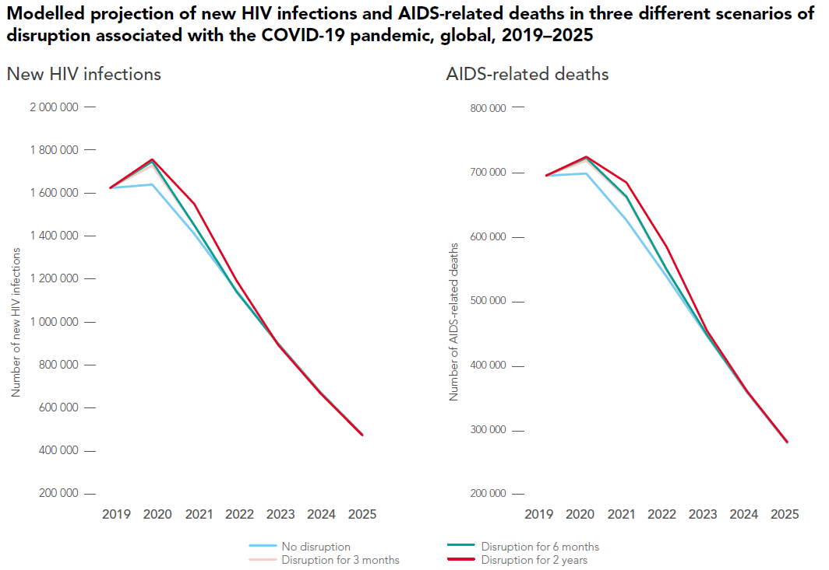
Results
Effects of disruptions will largely disappear by 2025 if we are able to catch-up to targets
However, during 2020-2025 disruptions could lead to:
120,000 - 290,000 new HIV infections
70,000 – 150,000 additional AIDS deaths
Source: UNAIDS, Prevailing Against Pandemics by Putting People at the Centre, World AIDS Day Report, 2020.
Notes:
We conducted prospective modeling for the new UNAIDS strategy (End Inequalities. End AIDS. Global AIDS Strategy 2021-2026, UNAIDS 2021). That modeling was used to examine the scope of prevention, treatment and social interventions needed to achieve the 2030 targets of reducing new infections and AIDS deaths by 90% from 2010 to 2030. As a special analysis, we looked at the effects of COVID-related disruptions on the achievement of these targets. These charts show the strategy targets in the lower blue lines and the effects of disruptions of 3 months, 6 months and 2 years on the achievement of the targets in the orange, green and red line. The results indicate that there might be some increase in new infections and HiV-related deaths in the next few years, but if we can catch up with the service targets by 2025 we can also get back on track to reaching the targeted reductions in new infections and HIV-related deaths. That is the good news. The bad news is that the disruptions over the next few years could result in 120,000 – 290,000 excess new infections during this period and 70,000 to 150,000 excess HIV-related deaths compared to a scenario with no disruptions.

Slide 10
Conclusion
Disruptions in HIV services due to COVID-19 are evident in program data, but most programs seem to have responded well to the challenges of maintaining essential HIV services
Continued support for these efforts is essential to averting a potential significant increase in HIV-related deaths
Notes:
Most programs have responded to these challenges by expanding multi-month drug supply, delivering drugs to patients in their homes, expanding the use of HIV self-tests and other approaches. These efforts seem to have been largely successful so far in mitigating the effects of COVID disruptions. These efforts need to be supported as the COVID challenge persists longer than initially anticipated. The longer-term effects can be minimized but only if we can maintain a fairly high level of services now and catch-up for the lost progress once the epidemic is under control.

